Slide 1
Exception

Slide 2
Agenda
Exception.
Handling Exceptions.
The finally Clause

Slide 3
Exception

Slide 4
Errors
Syntax errors : arise because the rules of the language have not been followed. They are detected by the compiler.
Runtime errors : occur while the program is running if the environment detects an operation that is impossible to carry out.
Logic errors : occur when a program doesn't perform the way it was intended to.

Slide 5
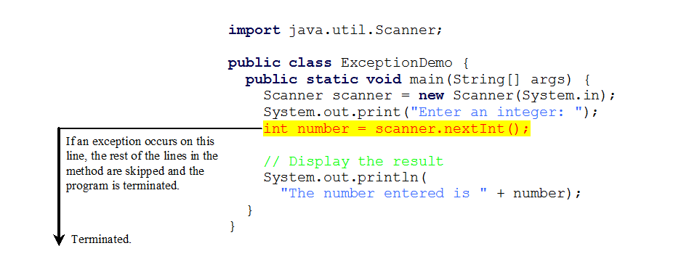
Runtime Errors

Slide 6
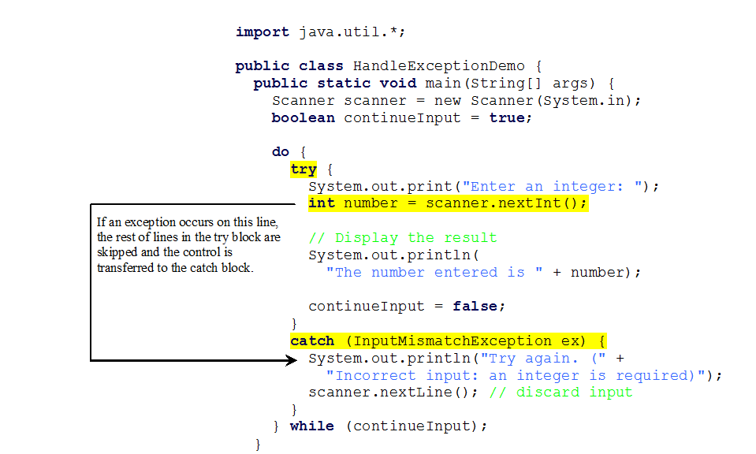
Catch Runtime Errors

Slide 7
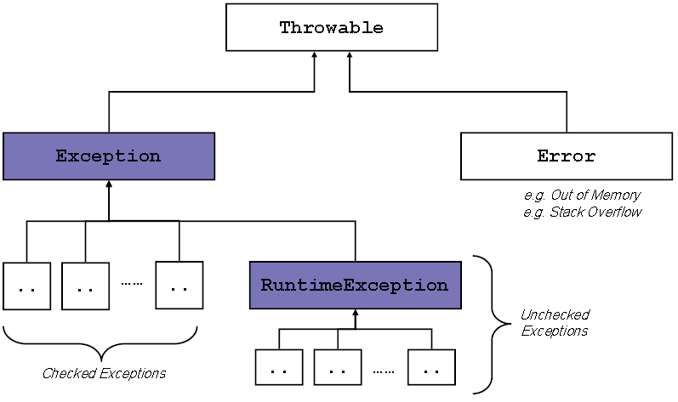
Checked Exceptions vs. Unchecked Exceptions

Slide 8
Checked vs. Unchecked Exceptions
RuntimeException, Error and their subclasses are known as unchecked exceptions.
All other exceptions are known as checked exceptions, meaning that the compiler forces the programmer to check and deal with the exceptions.
8

Slide 9
Unchecked Exceptions
In most cases, unchecked exceptions reflect programming logic errors that are not recoverable.
For example,
NullPointerException is thrown if you access an object through a reference variable before an object is assigned to it.
IndexOutOfBoundsException is thrown if you access an element in an array outside the bounds of the array.
9

Slide 10
Unchecked Exceptions
These are the logic errors that should be corrected in the program.
Unchecked exceptions can occur anywhere in the program.
To avoid cumbersome overuse of try-catch blocks, Java does not mandate you to write code to catch unchecked exceptions.
10

Slide 11
Handling Exceptions

Slide 12
Declaring and Catching Exceptions
Java's exception-handling model is based on three operations:
Declaring an exception.
Catching an exception.

Slide 13
Declaring Exceptions
Every method must state the types of checked exceptions it might throw. This is known as declaring exceptions.
Ex:
public void myMethod() throws IOException
public void myMethod() throws IOException, OtherException

Slide 14
Catching Exceptions
try {
statements; // Statements that may throw exceptions
}
catch (Exception1 exVar1) {
handler for exception1;
}
catch (Exception2 exVar2) {
handler for exception2;
}
...
catch (ExceptionN exVar3) {
handler for exceptionN;
}

Slide 15
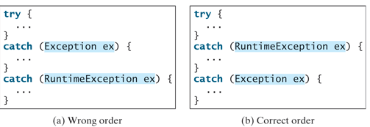
Catching Exceptions
The order in which exceptions are specified in catch blocks is important.
A compilation error will result if a catch block for a superclass type appears before a catch block for a subclass type.
Ex :

Slide 16
Catch or Declare Checked Exceptions
Java forces you to deal with checked exceptions.
If a method declares a checked exception, you must invoke it in a try-catch block or declare to throw the exception in the calling method.
Ex :

Slide 17
Getting Information from Exceptions
An exception object contains valuable information about the exception.
You may use the following instance methods to get information regarding the exception.

Slide 18
When to Use Exceptions
When should you use the try-catch block in the code?
You should use it to deal with unexpected error conditions.
Do not use it to deal with simple, expected situations. For example, the following code
try {
System.out.println(refVar.toString());
}
catch (NullPointerException ex) {
System.out.println("refVar is null");
}

Slide 19
When to Use Exceptions
Is better to be replaced by
if (refVar != null)
System.out.println(refVar.toString());
else
System.out.println("refVar is null");

Slide 20
The finally Clause

Slide 21
The finally Clause
you may want some code to be executed regardless of whether an exception occurs or is caught.
Java has a finally clause that can be used to accomplish this objective.
try {
statements;
} catch (TheException ex) {
handling ex;
} finally {
finalStatements;
}

Slide 22
Thanks

